Slide 1
Software Quality Assurance

Slide 2
What is software quality
software quality usually refers to two notions:
Software functional quality (SFQ)
This reflects on how well software conforms to a given design.
Software structural quality (SSQ)
This refers to how a piece of software meets it’s non-functional requirements support the delivery of the functional requirements.
Some quality control experts view software quality as something customers should define.
“Quality is a customer determination, not an engineer's determination, not a marketing determination, nor a general management determination.” – Feigenbaum on software quality

Slide 3
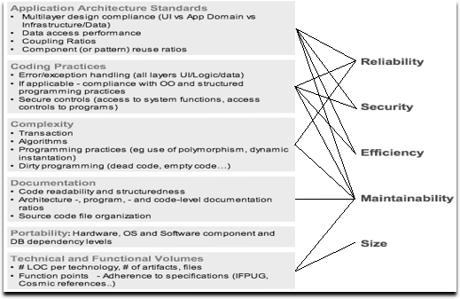
Measuring Quality
Software quality measurement is all about quantifying to what extent a system or software possesses characteristics that are desirable.
There is a dependency between these characteristics(right side) and measurable attributes(left side).
These characteristics and attributes are historically derived from the ISO 9126-3 quality model.
The characteristics are:
Reliability
Security
Efficiency
Maintainability
Size

Slide 4
Reliability, efficiency and security
Reliability is a measure of how stable a piece of software is, this can be impacted by several factors/attributes such as Application Architecture Practices but most of these fall under coding practices, such as error/exception handling, which if done poorly can make the software unreliable.
Efficiency of software is a determined by how well it performs. as with reliability, it is also impacted by most of the same attributes. It is also impacted by factors such as Memory, network and disk space management.
Security is how vulnerable a system/program is to unauthorised access. This can be affected by poor coding that allows techniques such as SQL injection to be used on a system to gain access or preform malicious actions.

Slide 5
Maintainability
The maintainability of a piece of software affects how easily it can be updated/changed when needed. This includes how modular, understandable and reusable the code is, as all of these factors can impact the difficulty in implementing needed changes.

Slide 6
Standards for quality
There are many standards available to help ensuring the quality of software developed
One standard is ISO/IEC 9126
This standard attempts to address well known problems that can affect software development.
It is divided into four parts:
quality model
external metrics
internal metrics
quality in use metrics.

Slide 7
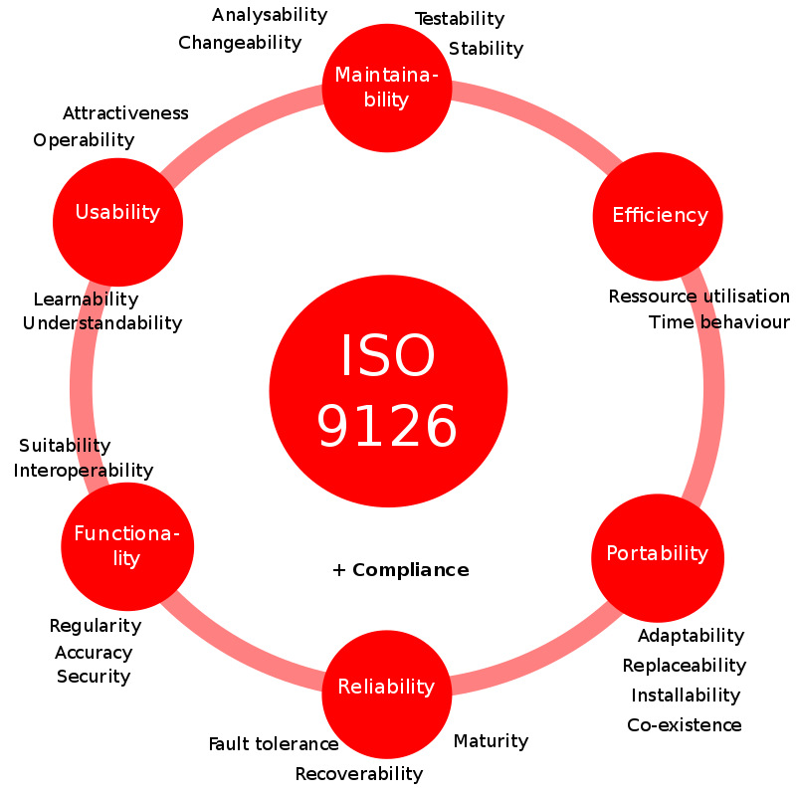
ISO 9126 is the standard that the measures of quality shown earlier are derived from and Efficiency, maintainability and reliability are comparable in each. However functionality, usability and portability are different. These characteristics make up the quality model
Functionality is deals with "the existence of a set of functions and their specified properties. The functions are those that satisfy stated or implied needs.”
Usability measures the effort needed to use the software.
Portability is the ability of software to be transferred from one environment to another.

Slide 8
Internal Metrics
Internal metrics are those which do not rely on software. These metrics gauge the quality of structure and code of software.
External metrics
External metrics are applicable to running software. As such these metrics gauge the quality of software functionality.
Quality in use metrics
these metrics are only available when the final product is used in real conditions. Ideally, the internal quality determines the external quality and external quality determines quality in use.

Slide 9
Case study 2 - IOE
Software quality assurance could be applied to case study 2, IOE group maintenance accounts, in several ways that greatly benefit the project.
The project manager could use a ISO 9126 quality standard to help ensure that the end product is reliable, efficient, easy to use and will be more easily maintained in the future due to the high standard of code developed.
By following ISO 9126, the project would also have a better chance at developing a system that functions accurately and is secure from any unauthorised access

Slide 10
References
http://www.rspa.com/spi/SQA.html.
http://asq.org/learn-about-quality/iso-9000/overview/overview.html.
https://en.wikipedia.org/wiki/ISO/IEC_9126#Developments
https://en.wikipedia.org/wiki/Software_quality

